Slide 1
JSP(Java Server Pages)
JSP technology is used to create web application just like Servlet technology. It can be thought of as an extension to Servlet because it provides more functionality than servlet such as expression language, JSTL, etc.
A JSP page consists of HTML tags and JSP tags. The JSP pages are easier to maintain than Servlet because we can separate designing and development. It provides some additional features such as Expression Language, Custom Tags, etc.

Slide 2
Advantages of JSP over Servlet
There are many advantages of JSP over the Servlet. They are as follows:
1) Extension to Servlet
JSP technology is the extension to Servlet technology. We can use all the features of the Servlet in JSP. In addition to, we can use implicit objects, predefined tags, expression language and Custom tags in JSP, that makes JSP development easy.

Slide 3
Advantages of JSP over Servlet
2) Easy to maintain
JSP can be easily managed because we can easily separate our business logic with presentation logic. In Servlet technology, we mix our business logic with the presentation logic.
3) Fast Development: No need to recompile and redeploy
If JSP page is modified, we don't need to recompile and redeploy the project. The Servlet code needs to be updated and recompiled if we have to change the look and feel of the application.

Slide 4
Advantages of JSP over Servlet
4) Less code than Servlet
In JSP, we can use many tags such as action tags, JSTL, custom tags, etc. that reduces the code. Moreover, we can use EL, implicit objects, etc.

Slide 5
The Lifecycle of a JSP Page
The JSP pages follow these phases:
Translation of JSP Page
Compilation of JSP Page
Classloading (the classloader loads class file)
Instantiation (Object of the Generated Servlet is created).
Initialization ( the container invokes jspInit() method).
Request processing ( the container invokes _jspService() method).
Destroy ( the container invokes jspDestroy() method).
Note: jspInit(), _jspService() and jspDestroy() are the life cycle methods of JSP.

Slide 6
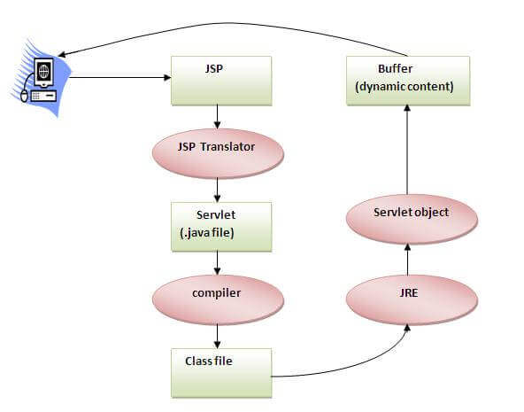
The Lifecycle of a JSP Page

Slide 7
The Lifecycle of a JSP Page
As depicted in the above diagram, JSP page is translated into Servlet by the help of JSP translator. The JSP translator is a part of the web server which is responsible for translating the JSP page into Servlet. After that, Servlet page is compiled by the compiler and gets converted into the class file. Moreover, all the processes that happen in Servlet are performed on JSP later like initialization, committing response to the browser and destroy.

Slide 8
Creating a simple JSP Page
To create the first JSP page, write some HTML code as given below, and save it by .jsp extension. We have saved this file as index.jsp. Put it in a folder and paste the folder in the web-apps directory in apache tomcat to run the JSP page.

Slide 9
Creating a simple JSP Page
index.jsp
Let's see the simple example of JSP where we are using the scriptlet tag to put Java code in the JSP page. We will learn scriptlet tag later.
<html>
<body>
<% out.print(2*5); %>
</body>
</html>
It will print 10 on the browser.

Slide 10
How to run a simple JSP Page?
Follow the following steps to execute this JSP page:
Start the server
Put the JSP file in a folder and deploy on the server
Visit the browser by the URL http://localhost:portno/contextRoot/jspfile, for example, http://localhost:8888/myapplication/index.jsp

Slide 11
JSP Scriptlet tag (Scripting elements)
In JSP, java code can be written inside the jsp page using the scriptlet tag. Let's see what are the scripting elements first.
The scripting elements provides the ability to insert java code inside the jsp. There are three types of scripting elements:
scriptlet tag
expression tag
declaration tag

Slide 12
JSP scriptlet tag
A scriptlet tag is used to execute java source code in JSP. Syntax is as follows:
<% java source code %>

Slide 13
Example of JSP scriptlet tag
<html>
<body>
<% out.print("welcome to jsp"); %>
</body>
</html>

Slide 14
JSP expression tag
The code placed within JSP expression tag is written to the output stream of the response. So you need not write out.print() to write data. It is mainly used to print the values of variable or method.
Syntax of JSP expression tag
<%= statement %>
Example of JSP expression tag
<html>
<body>
<%= "welcome to jsp" %>
</body>
</html>
Note: Do not end your statement with semicolon in case of expression tag.

Slide 15
JSP Declaration Tag
The JSP declaration tag is used to declare fields and methods.
The code written inside the jsp declaration tag is placed outside the service() method of auto generated servlet.
So it doesn't get memory at each request.
The syntax of the declaration tag is as follows:
<%! field or method declaration %>

Slide 16
Difference between JSP Scriptlet tag and Declaration tag
Jsp Scriptlet Tag | Jsp Declaration Tag
The jsp scriptlet tag can only declare variables not methods. | The jsp declaration tag can declare variables as well as methods.
The declaration of scriptlet tag is placed inside the _jspService() method. | The declaration of jsp declaration tag is placed outside the _jspService() method.

Slide 17
Example of JSP declaration tag that declares field
<html>
<body>
<%! int data=50; %>
<%= "Value of the variable is:"+data %>
</body>
</html>

Slide 18
JSP directives
The jsp directives are messages that tells the web container how to translate a JSP page into the corresponding servlet.
There are three types of directives:
page directive
include directive
taglib directive
Syntax of JSP Directive
%@ directive attribute="value" %>

Slide 19
JSP page directive
The page directive defines attributes that apply to an entire JSP page.
Syntax of JSP page directive
<%@ page attribute="value" %>
Attributes of JSP page directive
import
contentType
extends
info
buffer

Slide 20
JSP page directive
language
isELIgnored
isThreadSafe
autoFlush
session
pageEncoding
errorPage
isErrorPage

Slide 21
JSP page directive
1)Import
The import attribute is used to import class,interface or all the members of a package.It is similar to import keyword in java class or interface.
Example of import attribute

Slide 22
JSP page directive
<html>
<body>
<%@ page import="java.util.Date" %>
Today is: <%= new Date() %>
</body>
</html>

Slide 23
JSP page directive
2)contentType
The contentType attribute defines the MIME(Multipurpose Internet Mail Extension) type of the HTTP response.The default value is "text/html;charset=ISO-8859-1".
Example of contentType attribute

Slide 24
JSP page directive
<html>
<body>
<%@ page contentType=application/msword %>
Today is: <%= new java.util.Date() %>
</body>
</html>

Slide 25
JSP page directive
3)extends
The extends attribute defines the parent class that will be inherited by the generated servlet.It is rarely used.

Slide 26
Jsp Include Directive
The include directive is used to include the contents of any resource it may be jsp file, html file or text file. The include directive includes the original content of the included resource at page translation time (the jsp page is translated only once so it will be better to include static resource).
Advantage of Include directive
Code Reusability
Syntax of include directive
<%@ include file="resourceName" %>

Slide 27
Jsp Include Directive
Example of include directive
<html>
<body>
<%@ include file="header.html" %>
Today is: <%= java.util.Calendar.getInstance().getTime() %>
</body>
</html>

Slide 28
JSP Taglib directive
The JSP taglib directive is used to define a tag library that defines many tags. We use the TLD (Tag Library Descriptor) file to define the tags. In the custom tag section we will use this tag so it will be better to learn it in custom tag.
Syntax JSP Taglib directive
<%@ taglib uri="uriofthetaglibrary" prefix="prefixoftaglibrary" %>

Slide 29
JSP Taglib directive
Example of JSP Taglib directive
<html>
<body>
<%@ taglib uri="http://www.javatpoint.com/tags" prefix="mytag" %>
<mytag:currentDate/>
</body>
</html>

Slide 30
JSP Implicit Objects
There are 9 jsp implicit objects. These objects are created by the web container that are available to all the jsp pages.
The available implicit objects are out, request, config, session, application etc.
A list of the 9 implicit objects is given below:

Slide 31
JSP Implicit Objects
Object | Type
out | JspWriter
request | HttpServletRequest
response | HttpServletResponse
config | ServletConfig
application | ServletContext
session | HttpSession
pageContext | PageContext
page | Object
exception | Throwable

Slide 32
Custom Tags in JSP
Custom tags are user-defined tags. They eliminates the possibility of scriptlet tag and separates the business logic from the JSP page.
The same business logic can be used many times by the use of custom tag.
Advantages of Custom Tags
The key advantages of Custom tags are as follows:
Eliminates the need of scriptlet tag The custom tags eliminates the need of scriptlet tag which is considered bad programming approach in JSP.
Separation of business logic from JSP The custom tags separate the the business logic from the JSP page so that it may be easy to maintain.
Re-usability The custom tags makes the possibility to reuse the same business logic again and again.

Slide 33
JSP Custom Tag API
The javax.servlet.jsp.tagext package contains classes and interfaces for JSP custom tag API. The JspTag is the root interface in the Custom Tag hierarchy.

Slide 34
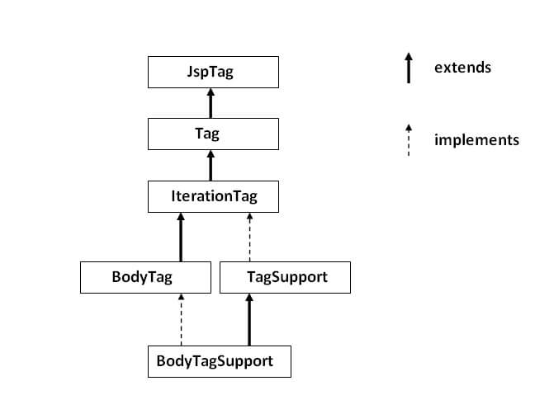

Slide 35
JSP Custom Tag API
JspTag interface
The JspTag is the root interface for all the interfaces and classes used in custom tag. It is a marker interface.
Tag interface
The Tag interface is the sub interface of JspTag interface. It provides methods to perform action at the start and end of the tag.
Fields of Tag interface
There are four fields defined in the Tag interface. They are:

Slide 36
JSP Custom Tag API
Field Name | Description
public static int EVAL_BODY_INCLUDE | it evaluates the body content.
public static int EVAL_PAGE | it evaluates the JSP page content after the custom tag.
public static int SKIP_BODY | it skips the body content of the tag.
public static int SKIP_PAGE | it skips the JSP page content after the custom tag.

Slide 37
Methods of Tag interface
Method Name | Description
public void setPageContext(PageContext pc) | it sets the given PageContext object.
public void setParent(Tag t) | it sets the parent of the tag handler.
public Tag getParent() | it returns the parent tag handler object.
public int doStartTag()throws JspException | it is invoked by the JSP page implementation object. The JSP programmer should override this method and define the business logic to be performed at the start of the tag.
public int doEndTag()throws JspException | it is invoked by the JSP page implementation object. The JSP programmer should override this method and define the business logic to be performed at the end of the tag.
public void release() | it is invoked by the JSP page implementation object to release the state.

Slide 38
JSP Custom Tag API
IterationTag interface
The IterationTag interface is the sub interface of the Tag interface. It provides an additional method to reevaluate the body.
Field of IterationTag interface
There is only one field defined in the IterationTag interface. public static int EVAL_BODY_AGAIN it reevaluates the body content.
Method of Tag interface
public int doAfterBody()throws JspException it is invoked by the JSP page implementation object after the evaluation of the body. If this method returns EVAL_BODY_INCLUDE, body content will be reevaluated, if it returns SKIP_BODY, no more body cotent will be evaluated.

Slide 39
JSP Custom Tag API
TagSupport class
The TagSupport class implements the IterationTag interface. It acts as the base class for new Tag Handlers. It provides some additional methods also.

Slide 40
Example of JSP Custom Tag
In this example, we are going to create a custom tag that prints the current date and time. We are performing action at the start of tag.
For creating any custom tag, we need to follow following steps:
Create the Tag handler class and perform action at the start or at the end of the tag.
Create the Tag Library Descriptor (TLD) file and define tags
Create the JSP file that uses the Custom tag defined in the TLD file

Slide 41
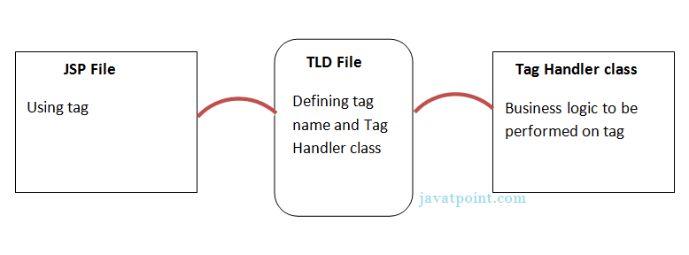
Example of JSP Custom Tag
Understanding flow of custom tag in jsp

Slide 42
1) Create the Tag handler class
To create the Tag Handler, we are inheriting the TagSupport class and overriding its method doStartTag().To write data for the jsp, we need to use the JspWriter class.
The PageContext class provides getOut() method that returns the instance of JspWriter class. TagSupport class provides instance of pageContext bydefault.

Slide 43
package com.javatpoint.sonoo;
import java.util.Calendar;
import javax.servlet.jsp.JspException;
import javax.servlet.jsp.JspWriter;
import javax.servlet.jsp.tagext.TagSupport;
public class MyTagHandler extends TagSupport{
public int doStartTag() throws JspException {
JspWriter out=pageContext.getOut();//returns the instance of JspWriter
try{
out.print(Calendar.getInstance().getTime());//printing date and time using JspWriter
}catch(Exception e){System.out.println(e);}
return SKIP_BODY;//will not evaluate the body content of the tag
} }

Slide 44
2) Create the TLD file
Tag Library Descriptor (TLD) file contains information of tag and Tag Hander classes. It must be contained inside the WEB-INF directory.
File: mytags.tld
<?xml version="1.0" encoding="ISO-8859-1" ?>
<!DOCTYPE taglib
PUBLIC "-//Sun Microsystems, Inc.//DTD JSP Tag Library 1.2//EN"
"http://java.sun.com/j2ee/dtd/web-jsptaglibrary_1_2.dtd">
<taglib>

Slide 45
<taglib>
<tlib-version>1.0</tlib-version>
<jsp-version>1.2</jsp-version>
<short-name>simple</short-name>
<uri>http://tomcat.apache.org/example-taglib</uri>
<tag>
<name>today</name>
<tag-class>com.javatpoint.sonoo.MyTagHandler</tag-class>
</tag>
</taglib>

Slide 46
3) Create the JSP file
Let's use the tag in our jsp file. Here, we are specifying the path of tld file directly. But it is recommended to use the uri name instead of full path of tld file. We will learn about uri later.
It uses taglib directive to use the tags defined in the tld file.
File: index.jsp
<%@ taglib uri="WEB-INF/mytags.tld" prefix="m" %>
Current Date and Time is: <m:today/>

Slide 47
Attributes in JSP Custom Tag
There can be defined too many attributes for any custom tag. To define the attribute, you need to perform two tasks:
Define the property in the TagHandler class with the attribute name and define the setter method
define the attribute element inside the tag element in the TLD file

Slide 48
Simple example of attribute in JSP Custom Tag
In this example, we are going to use the cube tag which return the cube of any given number. Here, we are defining the number attribute for the cube tag. We are using the three file here:
index.jsp
CubeNumber.java
mytags.tld
index.jsp
<%@ taglib uri="WEB-INF/mytags.tld" prefix="m" %>
Cube of 4 is: <m:cube number="4"></m:cube>

Slide 49
CubeNumber.java
package com.javatpoint.taghandler;
import javax.servlet.jsp.JspException;
import javax.servlet.jsp.JspWriter;
import javax.servlet.jsp.tagext.TagSupport;
public class CubeNumber extends TagSupport{
private int number;
public void setNumber(int number) {
this.number = number;
}
public int doStartTag() throws JspException {
JspWriter out=pageContext.getOut();
try{
out.print(number*number*number);
}catch(Exception e){e.printStackTrace();}
return SKIP_BODY;
}
}

Slide 50
mytags.tld
<?xml version="1.0" encoding="ISO-8859-1" ?>
<!DOCTYPE taglib
PUBLIC "-//Sun Microsystems, Inc.//DTD JSP Tag Library 1.2//EN"
"http://java.sun.com/j2ee/dtd/web-jsptaglibrary_1_2.dtd">
<taglib>
<tlib-version>1.0</tlib-version>
<jsp-version>1.2</jsp-version>
<short-name>simple</short-name>
<uri>http://tomcat.apache.org/example-taglib</uri>
<description>A simple tab library for the examples</description>
<tag>
<name>cube</name>
<tag-class>com.javatpoint.taghandler.CubeNumber</tag-class>
<attribute>
<name>number</name>
<required>true</required>
</attribute>
</tag>
</taglib>

Slide 51
Page Redirecting
We utilize page redirection when a document moves to a new location, and we need to send the client to that new location. This could be for load balance or simple randomized purposes. The sendRedirect() method of the response object is the easiest to redirect a request to another page.
Example:

Slide 52
Page1.jsp
<%--
Document : page1
Created on : May 23, 2024, 1:07:36 PM
Author : Saitech
--%>
<%@page contentType="text/html" pageEncoding="UTF-8"%>
<!DOCTYPE html>
<html>
<head>
<meta http-equiv="Content-Type" content="text/html; charset=UTF-8">
<title>JSP Page</title>
</head>
<body>
<h1>This is page one</h1>
<a href="page2.jsp">Go to page 2</a>
</body>
</html>

Slide 53
Page2.jsp
<%--
Document : page2
Created on : May 23, 2024, 1:07:59 PM
Author : Saitech
--%>
<%@page contentType="text/html" pageEncoding="UTF-8"%>
<!DOCTYPE html>
<html>
<head>
<meta http-equiv="Content-Type" content="text/html; charset=UTF-8">
<title>JSP Page</title>
</head>
<body>
<h1>This is page Two</h1>
<%
// response.sendRedirect("page3.jsp");
response .sendRedirect("https://www.facebook.com");
%>
</body>
</html>

Slide 54
Page3.jsp
<%--
Document : page3
Created on : May 23, 2024, 1:08:13 PM
Author : Saitech
--%>
<%@page contentType="text/html" pageEncoding="UTF-8"%>
<!DOCTYPE html>
<html>
<head>
<meta http-equiv="Content-Type" content="text/html; charset=UTF-8">
<title>JSP Page</title>
</head>
<body>
<h1>This is page three</h1>
</body>
</html>

Slide 55
JSTL (JSP Standard Tag Library)
The JSP Standard Tag Library (JSTL) represents a set of tags to simplify the JSP development.
Advantage of JSTL
Fast Development JSTL provides many tags that simplify the JSP.
Code Reusability We can use the JSTL tags on various pages.
No need to use scriptlet tag It avoids the use of scriptlet tag.

